Slide 1
Object Oriented Programming Lecture - 4
Prof. Dnyaneshwar Kanade

Slide 2
Static Class in Java
In Java concept of static class is introduced under concept of inner classes, which are specially designed for some delicate functionality in a class.
Static class in Java are allowed only for inner classes which are defined under some other class, as static outer class is not allowed which means that we can't use static keyword with outer class.
Static class are defined same as other inner class in Java only with static keyword in front of its name.

Slide 3
Static Class in Java
These class have some unique characteristics which made them differ from other non static inner class, these features of static class are as mentioned below −
Static class do not need to create an instance of outer containing class in order to create its own instance.
Static class can access members(variables/methods) of outer containing class only if they are static in nature.
Which means that a static nested class does not have access to the instance variables and methods of the outer class.
Static Class in Java

Slide 4
Operators in Java
Java provides a rich operator environment.
Most of its operators can be divided into the following four groups:
Arithmetic
Bitwise
Relational
Logical

Slide 5
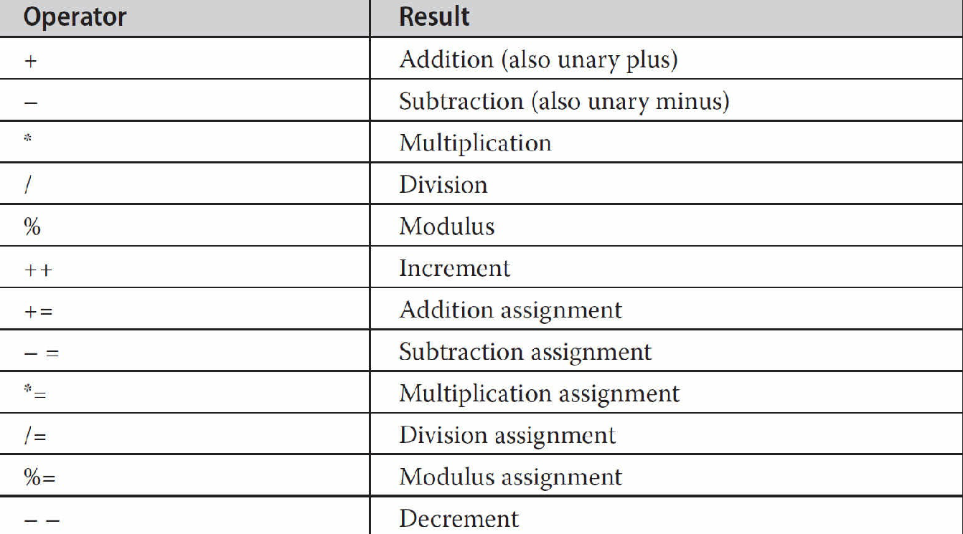
Operators in Java
Arithmetic Operators

Slide 6
Operators in Java
Arithmetic Operators
Modulus Operator
Arithmetic Compound Assignment Operators
Increment & Decrement Operators

Slide 7
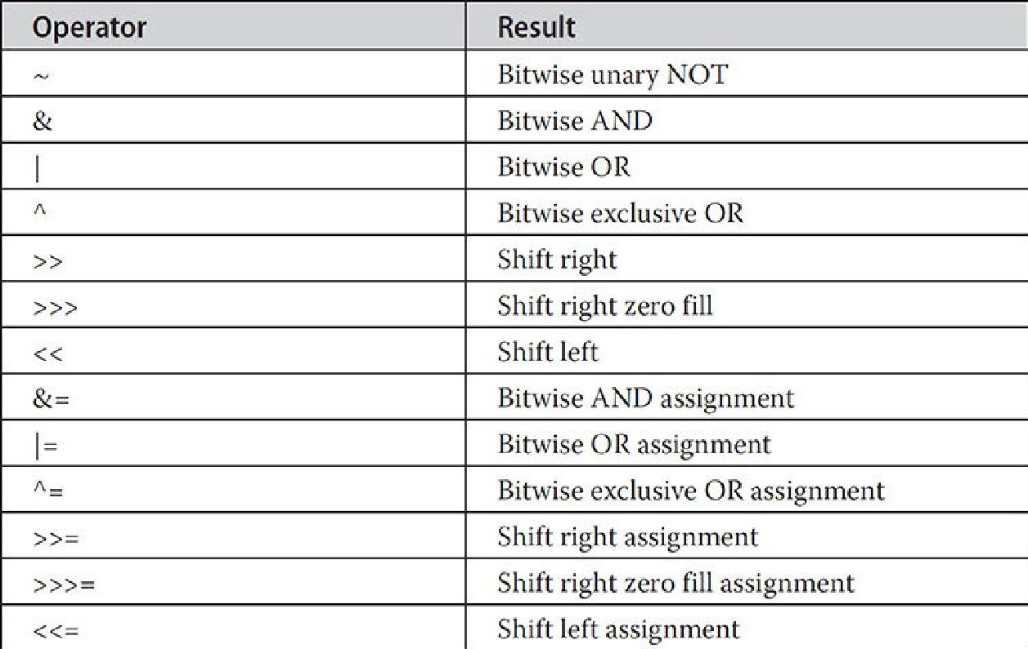
Operators in Java
The Bitwise Operators
Java defines several bitwise operators that can be applied to the integer types: long, int, short, char, and byte.
These operators act upon the individual bits of their operands.

Slide 8
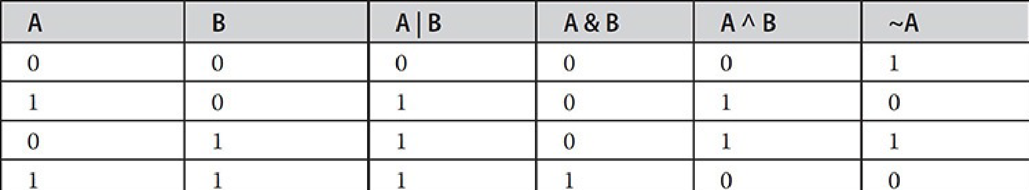
Operators in Java
The Bitwise Logical Operators
The bitwise logical operators are &, |, ^, and ~.
Bitwise operators are applied to each individual bit within each operand.
Example

Slide 9
Operators in Java
The Left Shift
The left shift operator, <<, shifts all of the bits in a value to the left a specified number of times. It has this general form:
value << num
The Right Shift
The right shift operator, >>, shifts all of the bits in a value to the right a specified number of times. Its general form is shown here:
value >> num
Example

Slide 10
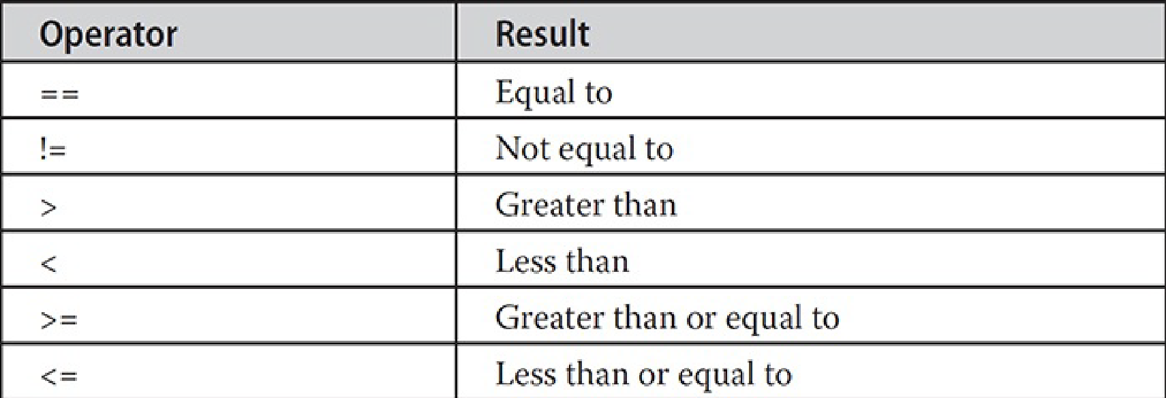
Operators in Java
Relational Operators
The relational operators determine the relationship that one operand has to the other. Specifically, they determine equality and ordering.
The outcome of these operations is a boolean value.

Slide 11
Operators in Java
Relational Operators
The relational operators are most frequently used in the expressions that control the if statement and the various loop statements.
Example

Slide 12
Operators in Java
Boolean Logical Operators
The Boolean logical operators shown here operate only on boolean operands.
All of the binary logical operators combine two boolean values to form a resultant boolean value.
The logical Boolean operators, &, |, and ^, operate on boolean values in the same way that they operate on the bits of an integer.
The logical ! Operator inverts the Boolean state: !true == false and !false == true.

Slide 13
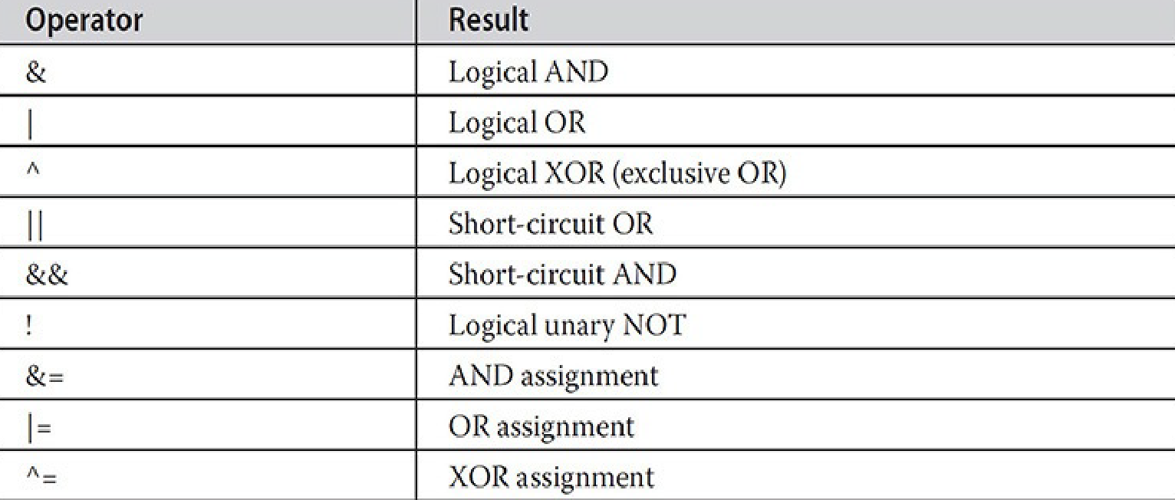
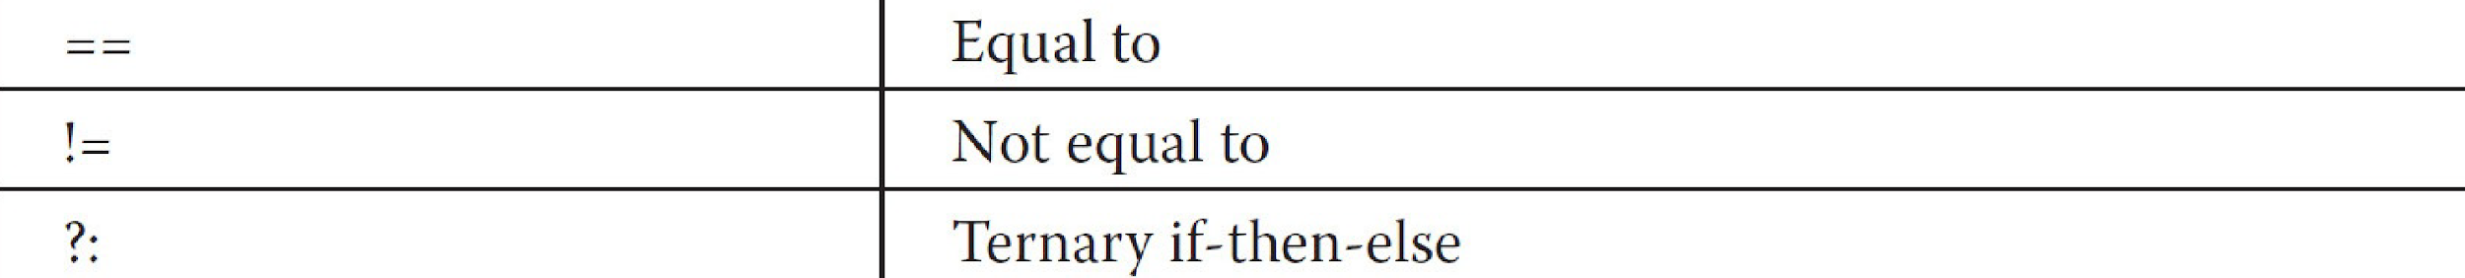
Operators in Java

Slide 14
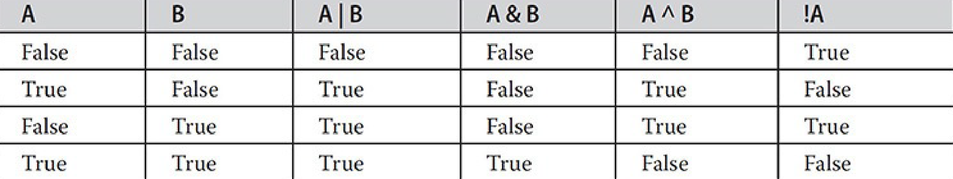
Operators in Java
Boolean Logical Operators
Example

Slide 15
Operators in Java
The Assignment Operator
The assignment operator is the single equal sign, =.
The assignment operator works in Java much as it does in any other computer language. It has this general form:
var = expression;
int x, y, z;
x = y = z = 100; // set x, y, and z to 100

Slide 16
Operators in Java
The ? Operator
Java includes a special ternary (three-way) operator that can replace certain types of if-then-else statements. This operator is the ?.
It can seem somewhat confusing at first, but the ? can be used very effectively once mastered.

Slide 17
Operators in Java
The ? Operator
The ? has this general form:
expression1 ? expression2 : expression3
Here, expression1 can be any expression that evaluates to a boolean value. If expression1 is true, then expression2 is evaluated; otherwise, expression3 is evaluated.
Example

Slide 18
Keywords used in Java
The Java Keywords
There are 61 keywords currently defined in the Java language.
These keywords, combined with the syntax of the operators and separators, form the foundation of the Java language.
In general, these keywords cannot be used as identifiers, meaning that they cannot be used as names for a variable, class, or method. The exceptions to this rule are the context-sensitive keywords added by JDK 9 to support modules.
Also, beginning with JDK 9, an underscore by itself is considered a keyword in order to prevent its use as the name of something in your program.

Slide 19
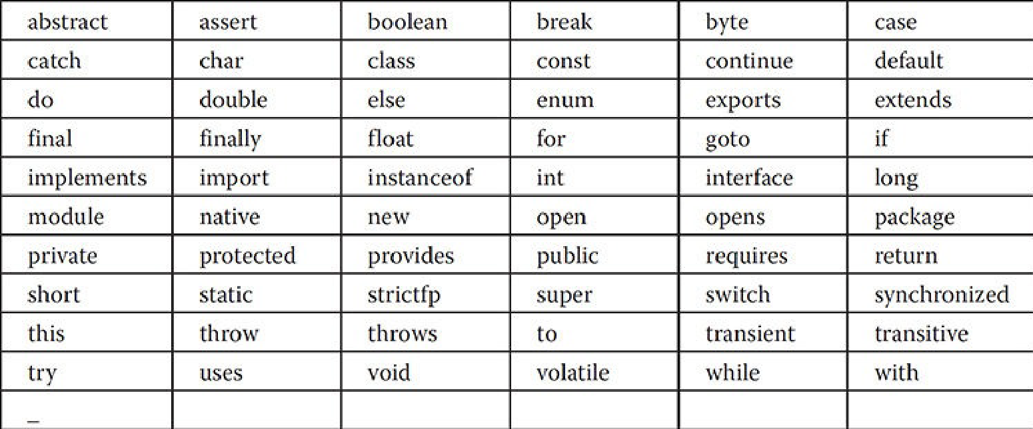
Keywords used in Java

Slide 20
Keywords used in Java
In addition to the keywords, Java reserves four other names. Three have been part of Java from the start: true, false, and null.
These are values defined by Java.
You may not use these words for the names of variables, classes, and so on.
Beginning with JDK 10, the word var has been added as a context sensitive, reserved type name.

